Slide 1
Data Mining Online News Popularity
Sachin Kant Misra
Prashant Bhowmik
Jagpreet Singh Sethi
Renee Champagne

Slide 2
Online News Popularity
Introduction
Problem Statement
Dataset Overview
Data Cleaning and Pre-Processing
Data Modeling and Conclusions
Problem 1: To predict the number of Mashable article shares
Problem 2: To predict binary target variable ‘Popularity’
Problem 3: To predict ordinal outcome for ‘Popularity_level’
Visualization using Tableau
Insight 1: How is the distribution of News articles in the month – January
Insight 2: Before shopping on Black Friday, people read and share lot of articles.
Insight 3: New York is the city of Business
Model Implementation on Amazon Web Server

Slide 3
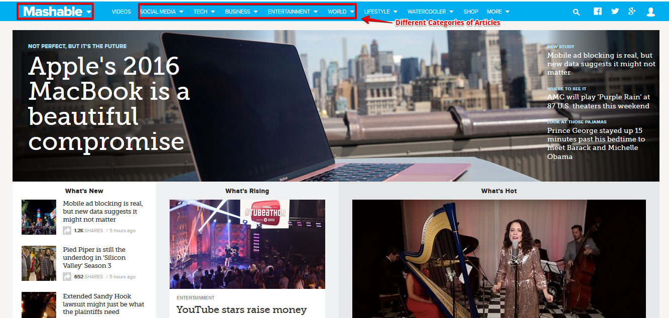
Introduction - Mashable website

Slide 4
Project aim
To predict the number of shares of Mashable article.
To predict the popularity status of the article
To predict an ordinal outcome for popularity levels
Visualize the dataset for various kinds of trend/insights found among the attributes of the Mashable article using tableau.
Popular (Yes) | Popular (No)
Share > 1400 | Shares <1400
PopularLevel (Low) | PopularLevel (Medium) | PopularLevel (High)
Share <1100 | Shares between 1100 and 2100 | Shares > 2100

Slide 5
Dataset overview
The data set was acquired on 8th January’ 2015.
Total 39644 instances and 71 attributes.
64 are independent predictors
4 are non-predictive variables
3 are target variables (Shares, Popularity, Popularity_Level)

Slide 6
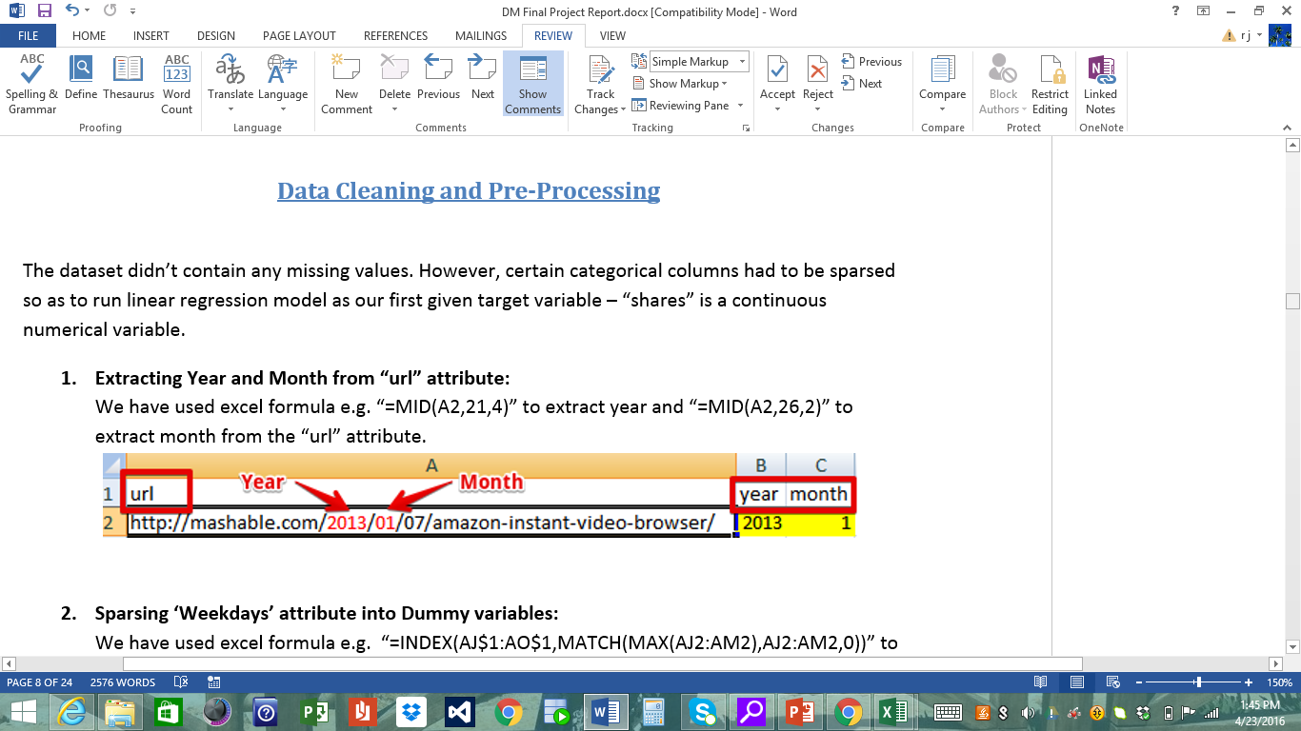
Data Cleaning-Extract Year & Month

Slide 7
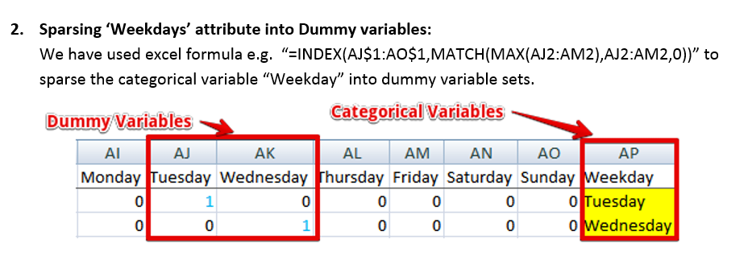
Data Cleaning-Create Dummy var

Slide 8
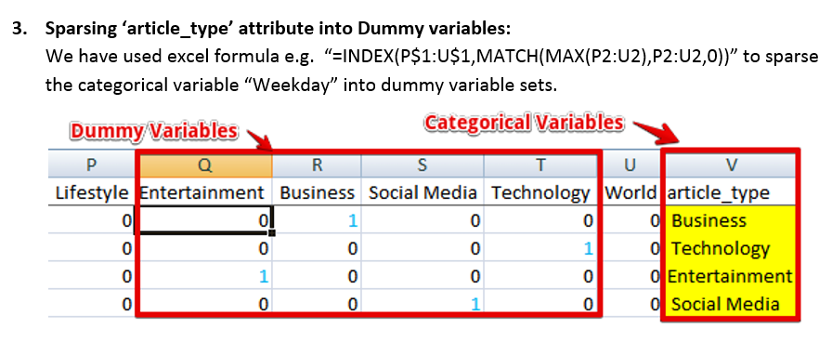
Data Cleaning-Create Dummy var

Slide 9
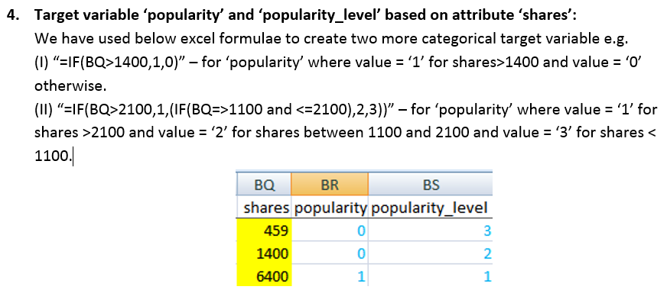
Data cleaning – create popularity levels

Slide 10
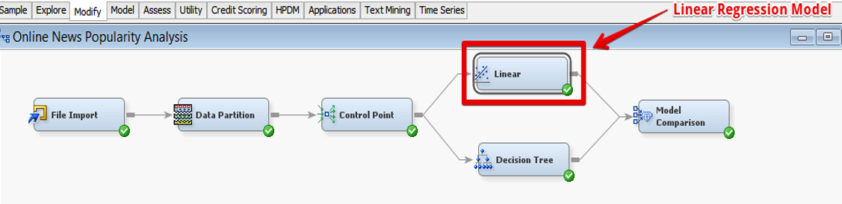
Objective 1 – predict shares
Approach 1: Use Kitchen Sink Model on Linear Regression algorithm
Results:
R-Squared | Adj R-Sq | Evaluation Criteria: MSE
0.0242 | 0.0199 | 51610069

Slide 11
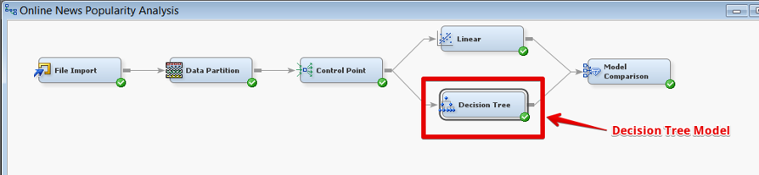
Objective 1 – predict shares
Approach 2: Use Kitchen Sink Model on Decision Tree algorithm
Parameters used and Results:
Depth | Leaf Size | No. of Rules | Interval Target Criteria | Evaluation Criteria: MSE
6 | 5 | 5 | ProfF | 51237007

Slide 12
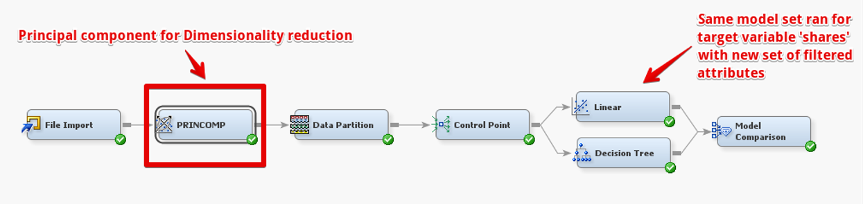
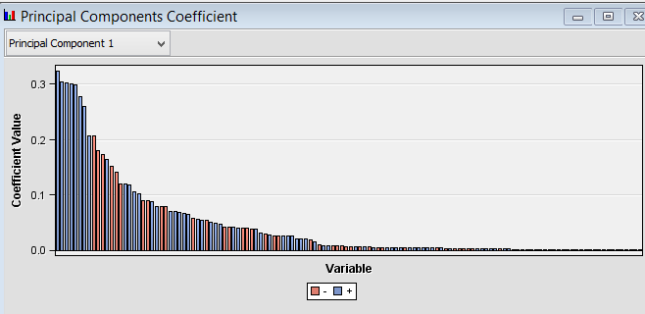
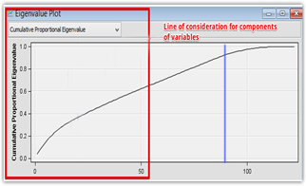
Objective 1 – predict shares
Approach 3: Use Principal Component Analysis and Linear Regression algorithm
Parameters used and Results:
EigenValue | Cumulative Cut Off | Interval Target Criteria | R-Sq | Adj R-Sq | Evaluation Criteria: MSE
Correlation | 0.8 | ProfF | 0.0143 | 0.0136 | 51482431

Slide 13
Objective 1 – predict shares
Approach 4: Use Principal Component Analysis and Decision Tree algorithm
Parameters used and Results:
Depth | Leaf Size | No. of Rules | Interval Target Criteria | EigenValue | Cumulative Cut Off | Evaluation Criteria: MSE
6 | 5 | 5 | ProfF | Correlation | 0.8 | 52753115

Slide 14
Objective 1 – CONCLUSION
Adjusted R-Square is very low in all our approaches (Approx 2%)
Only 2% of variance in target variable (‘shares’) can be explained which is too less to make predictions.
Similar is the case with stock price prediction example from the book ‘Data Science for Business’, where exact stock price value prediction cannot be made. In such situations, we use a threshold value on continuous target variable and try to predict ‘SURGE’ or ‘PLUNGE’ in the stock price.
Thus, we’ll predict popularity of Mashable article with a threshold
Popular [Shares > 1400]
Not Popular [Shares < 1400]

Slide 15
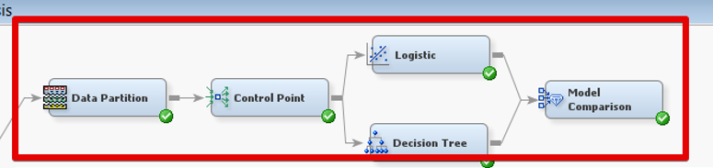
Objective 2 – predict Popularity
Approach 1: Use Kitchen Sink Model on Logistic Regression and Decision Tree algorithm
Logistic Regression Results:
Decision Tree Results:
False -ve | False +ve | MISC_ Rate | Evaluation Criteria: Accuracy
1492 | 1271 | 0.35 | 65%
False -ve | False +ve | MISC_ Rate | Evaluation Criteria: Accuracy
1379 | 1471 | 0.36 | 64%

Slide 16
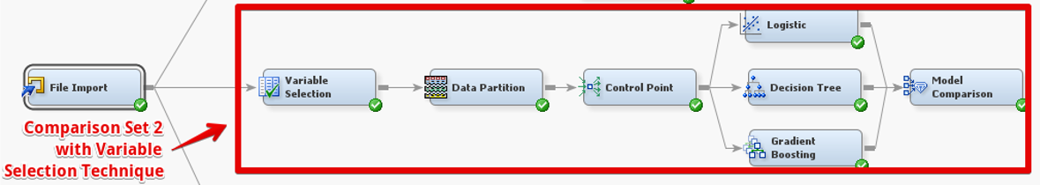
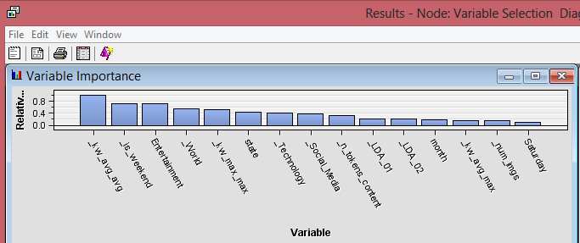
Objective 2 – predict Popularity
Approach 2: Use Variable Selection on Logistic Regression, Decision Tree & Gradient Boosting algorithm
Logistic Regression Results:
Decision Tree Results:
Gradient Boosting Results:
FN | FP | MISC_ Rate | Evaluation Criteria: Accuracy
1488 | 1441 | 0.37 | 63%
FN | FP | MISC_ Rate | Evaluation Criteria: Accuracy
1325 | 1530 | 0.36 | 64%
FN | FP | MISC_ Rate | Evaluation Criteria: Accuracy
1545 | 1451 | 0.38 | 62%

Slide 17
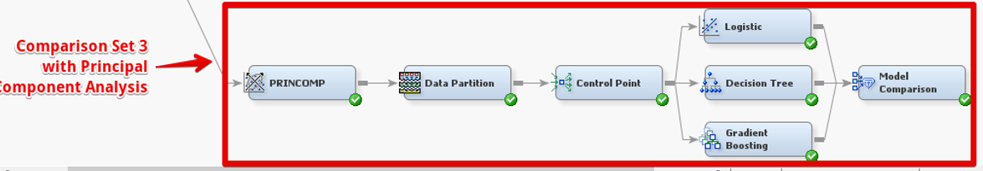
Objective 2 – predict Popularity
Approach 3: Use Principal Component Analysis on Logistic Regression, Decision Tree & Gradient Boosting algorithm
Logistic Regression Results:
Decision Tree Results:
Gradient Boosting Results:
FN | FP | MISC_ Rate | Evaluation Criteria: Accuracy
1533 | 1450 | 0.38 | 62%
FN | FP | MISC_ Rate | Evaluation Criteria: Accuracy
1235 | 1757 | 0.38 | 62%
FN | FP | MISC_ Rate | Evaluation Criteria: Accuracy
1400 | 1545 | 0.37 | 63%

Slide 18
Objective 2 – CONCLUSION
Although with a kitchen sink model, we achieved ~65% accuracy using logistic regression, the model seems too complex.
On compromising only ~1% accuracy, we built models using variable selection technique i.e. filtering input variables on R-Sq (for continuous) and Chi-Sq (for categorical). Thus, simplifying our model.
Considering the fact that the value of False Negative is more alarming as compared to False Positive. Our selected model should have least FP value i.e. a cost-effective model for business strategy.
As a result, we prefer Decision Tree with Variable Selection dimensionality reduction technique over any other model for prediction of binary target variable popularity.

Slide 19
Objective 3 – predict Ordinal Popularity_level
Approach 1: Use Kitchen Sink Model on Logistic Regression and Decision Tree algorithm
Logistic Regression Results:
Decision Tree Results:
False -ve | False +ve | MISC_ Rate | Evaluation Criteria: Accuracy
757 | 2207 | 0.52 | 48%
False -ve | False +ve | MISC_ Rate | Evaluation Criteria: Accuracy
869 | 2164 | 0.53 | 47%

Slide 20
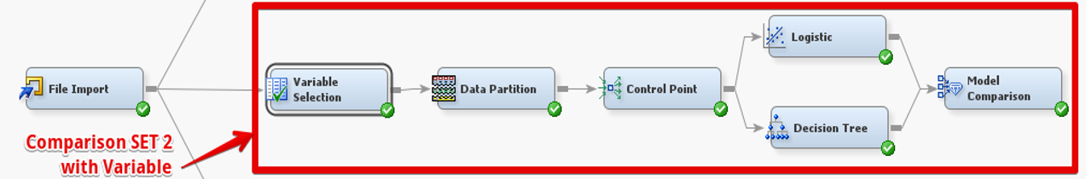
Objective 3 – predict Ordinal Popularity_level
Approach 2: Use Variable Selection on Logistic Regression & Decision Tree algorithm
Logistic Regression Results:
Decision Tree Results:
FN | FP | MISC_ Rate | Evaluation Criteria: Accuracy
748 | 2304 | 0.53 | 47%
FN | FP | MISC_ Rate | Evaluation Criteria: Accuracy
850 | 2234 | 0.53 | 47%

Slide 21
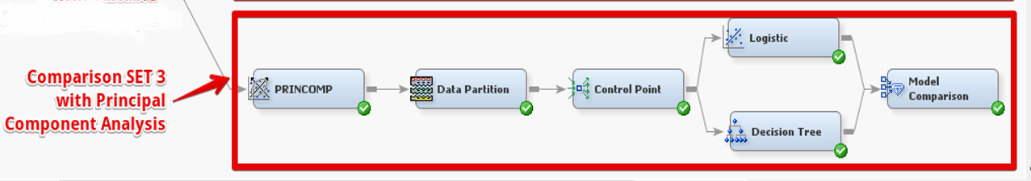
Objective 3 – predict Ordinal Popularity_level
Approach 3: Use Principal Component Analysis on Logistic Regression and Decision Tree algorithm
Logistic Regression Results:
Decision Tree Results:
FN | FP | MISC_ Rate | Evaluation Criteria: Accuracy
748 | 2433 | 0.54 | 46%
FN | FP | MISC_ Rate | Evaluation Criteria: Accuracy
811 | 2387 | 0.54 | 46%

Slide 22
Objective 3 – CONCLUSION
Although with a kitchen sink model, we achieved ~48% accuracy using logistic regression, the model seems too complex.
On compromising only ~1% accuracy, we built models using variable selection technique i.e. filtering input variables on R-Sq (for continuous) and Chi-Sq (for categorical). Thus, simplifying our model.
Considering the fact that the value of False Negative is more alarming as compared to False Positive. This rules out the option of choosing Decision Tree over Logistic Regression.
As a result, we prefer Logistic Regression with Variable Selection dimensionality reduction technique over any other model for prediction of Ordinal target variable popularity_level (High, Medium, Low)

Slide 23
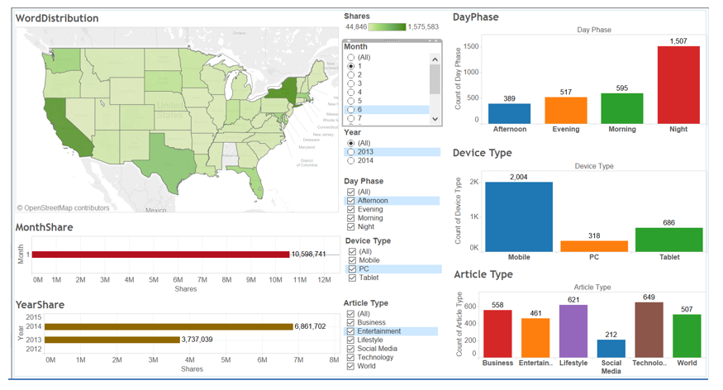
tableau visualization - 1 Public Tableau: https://public.tableau.com/profile/jagpreet#!/vizhome/book1_10486/dashboard1
Insight1: CES Conference by CNET in Jan makes people share more tech articles.
No. of shares in Jan 2014 is double than in Jan 2013.
Mobile device is preferred to read Mashable articles.
Cities - California, Texas, New York and Massachusetts has most of the authors.
Most authors post during night hours.
In Jan, people share maximum Technology related articles because the company CNET organizes CES product launch conference annually in the month of January.
Henceforth, people stay active and share more articles on technology in Jan.

Slide 24
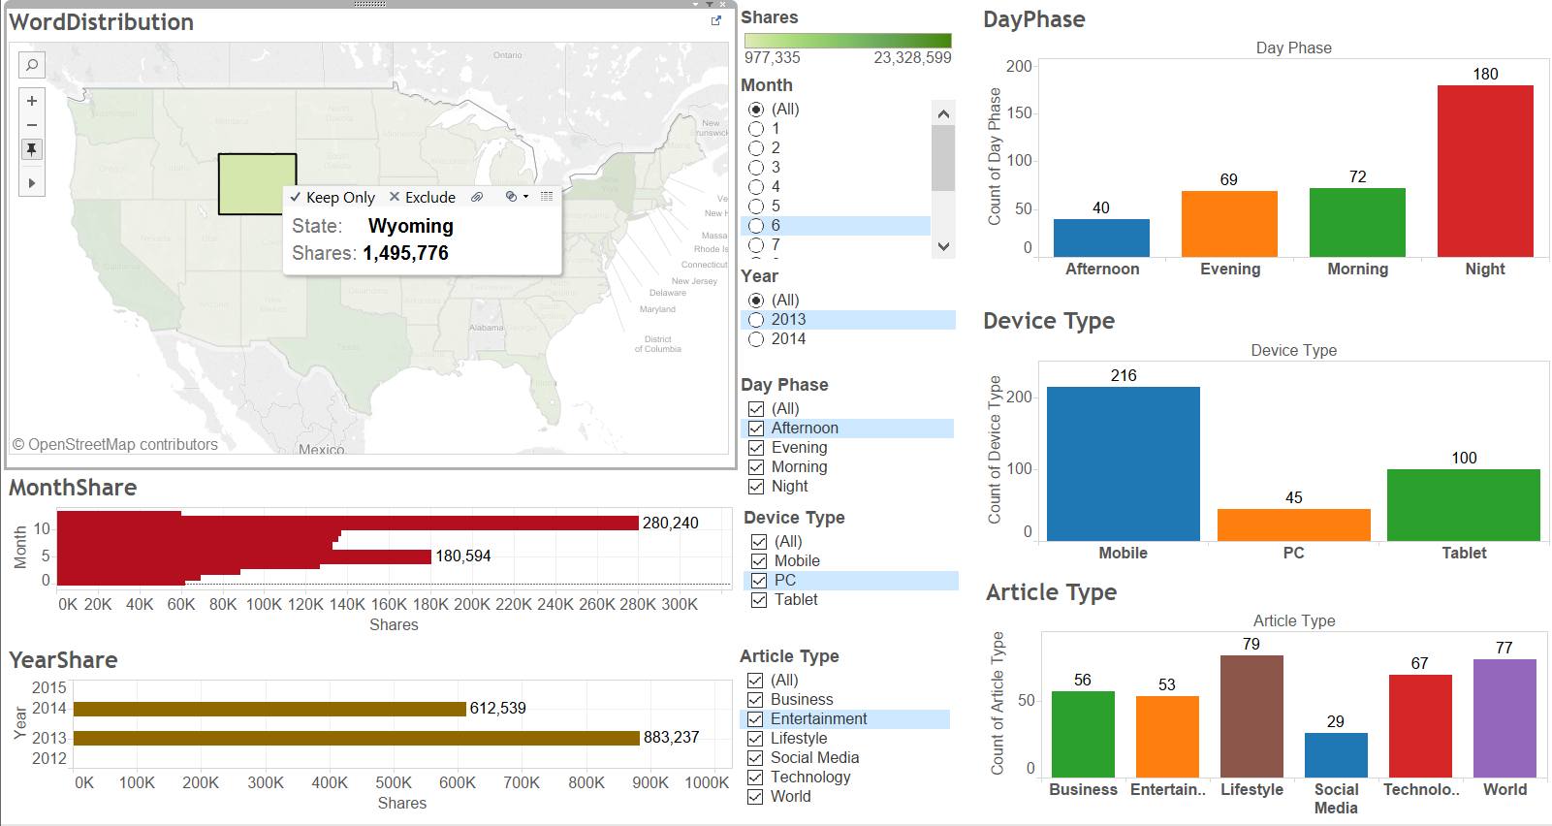
tableau visualization - 2 Public Tableau: https://public.tableau.com/profile/jagpreet#!/vizhome/book1_10486/dashboard1
Insight2: Christmas holiday and Black Friday week, make people visit Lifestyle related Mashable article even more.
Authors in Wyoming publish more Lifestyle related articles.
Such articles are shared more during last few months of a year.
Festive like Christmas Holiday, Black Friday and Labor Day bring heavy discount on shopping, this makes people visit Lifestyle related Mashable articles even more.

Slide 25
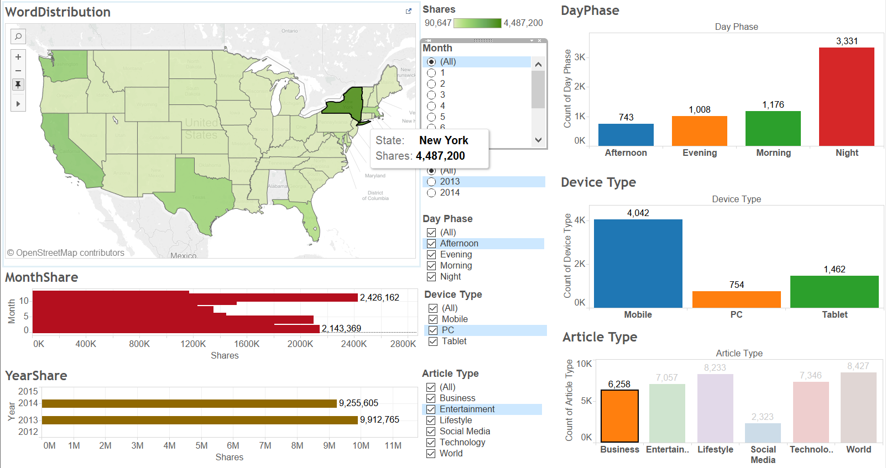
tableau visualization - 3 Public Tableau: https://public.tableau.com/profile/jagpreet#!/vizhome/book1_10486/dashboard1
Insight 3: New York is the city with maximum business-minded crowd
Most of the authors in New York publish articles on Mashable.com during night.
People working in NY love to read and share “Business” centric Mashable articles,
Henceforth, New York has maximum number of business-minded crowd.

Slide 26
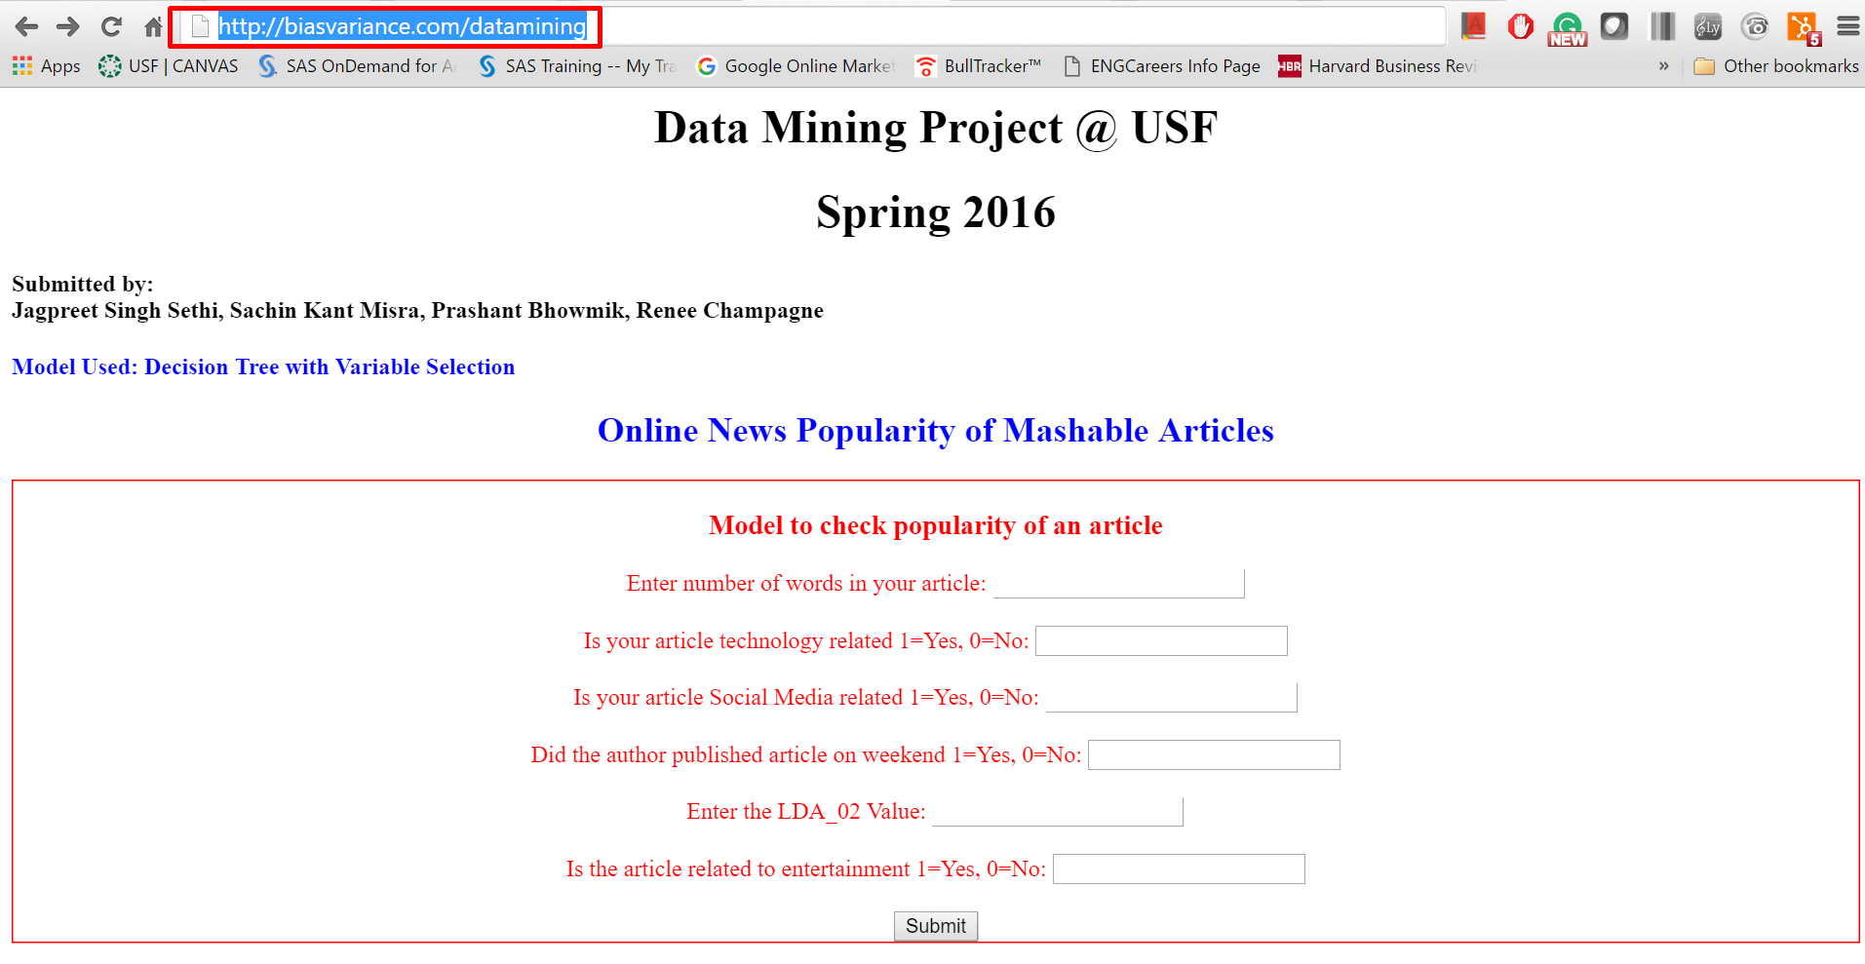
MODeL IMPLEMENTATION http://biasvariance.com/datamining ( deployed on Amazon Web Services)

Slide 27
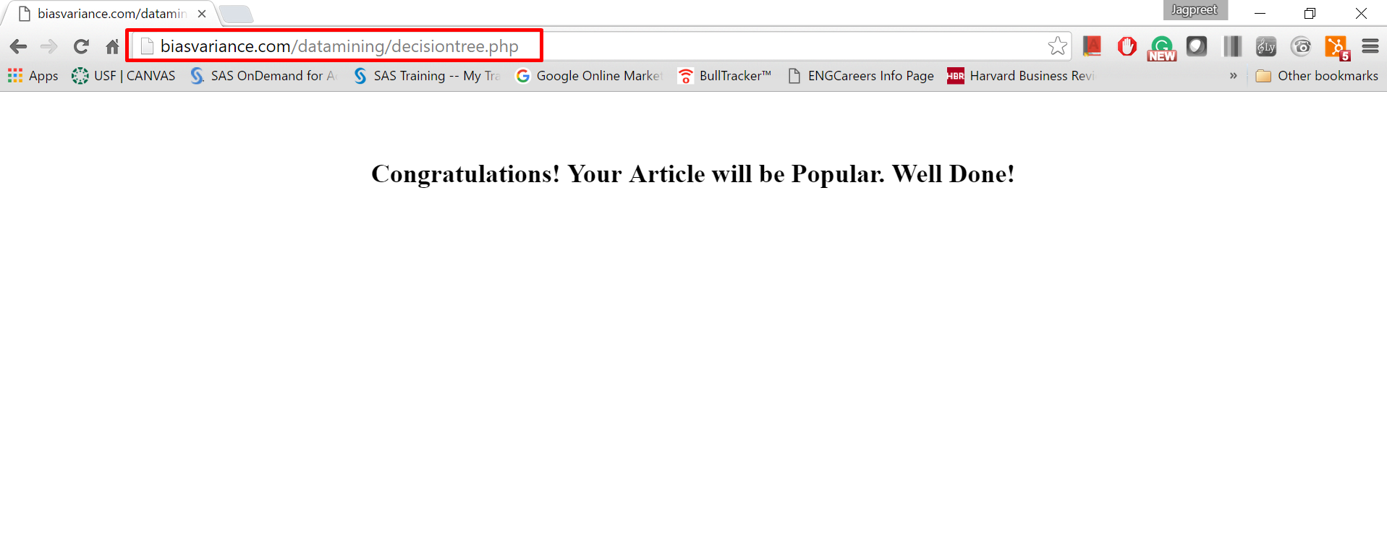
MODeL IMPLEMENTATION http://biasvariance.com/datamining ( deployed on Amazon Web Services)

Slide 28
Thank you!

